Slide 1

FLIGHT TICKET BOOKING
SRM INSTITUTE OF SCIENCE AND TECHNOLOGY
FACULTY OF ENGINEERING AND TECHNOLOGY
DEPARTMENT OF NETWORKING AND COMMUNICATIONS
18CSC101J- MINI PROJECT
Yathin Duruvu : RA2111026010110
Ravi Vamsi Krishna : RA2111026010114
Cheedella S V Abhinava Sai : RA2111026010127
Kurella Chaitanya : RA2111026010132
CSE Artificial intelligence and Machine learning T1 Section
Batch No: 2
Lab Instructor name: Shobana Mam

Slide 2
Table of contents
Introduction
Objectives
System requirement
Algorithm
Flowchart
Sample Coding
Snapshots of the result and discussion
Conclusion

Slide 3
INTRODUCTION
The title of our project is flight ticket booking.The reason for choosing this project is now a days airways making a key role for people to travel across the world or within the country itself. But many of the people don’t even know how to book a flight ticket.we made this project to make people learn more about flight ticket booking.And the reason we used C language - C has been used successfully for each kind of programming problem thinkable from operating systems to spreadsheets to expert systems - and efficient compilers are accessible for machines ranging in power from the Apple Macintosh to the Cray Supercomputers.

Slide 4
OBJECTIVES
A small airline has just purchased a computer for its new automated reservation system.The owner has asked to program the new system in C. It is required to write a program to assign seats on each flight of the airlines only place (capacity: 15 seats). The program should never assign a seat which is already assigned. If there’s no seat available, then print the message "the flight is full". After the flight is full and someone want to cancel the booking, it is displaying enter you’re the passport number you want to cancel it so after the passenger cancel it, the system directly free that place id someone want to book that seat. Moreover, the system should print a boarding pass indicating the persons' name, passport number and seat number as each seat is assigned, set the corresponding elements of array to 1 to indicate that seat is no longer available.

Slide 5
System Requirements
Any Operating System
Any C Compiler
4gb Ram

Slide 6
Algorithm

Slide 7
Step 1 :- First declare a structure of any name (vicar_airline in this)
Step 2 :- Declare the required type of data types with their names in the structure passport number and seat number in int
name,email in char
Step 3 :- And also declare a struct pointer named “following” of data type vicar_airline in the
structure itself
Step 4 :- Declare struct pointers pointers “begin” , “stream” out of the structure for universal
declaration
Step 5 :- Also declare pointer named “dummy”of data type vicar_airline out of structure
Step 6 :- Now write the prototype of the functions –
reservation(int x), cancel(), display(), savefile(), details().
Step 7 :- Declare a variable named choice of int data type.
Step 8 :- Initialize the struct pointers “begin” and “stream” to null

Slide 8
Step 9 :- Initialize int num to 1.
Step 10 :- Use do while loop and first print the four options –
1. Reservation
2. Cancellation
3. Display records
4. Exit
Step 11 :- Use switch case and accept the choice.
If the choice is 1 then call reservation function of of num and increment the num
If the choice is 2 then call the cancel function
If the choice is 3 then call the display function
If the choice is 4 then call the savefile function
If the choice is not between 1 to 4 then print it as the invalid choice
Step 12 :- In the details function accept all the details passenger
Passport number into the stream -> passport
Name into the stream -> name
Email id into the stream -> email

Slide 9
Step 13 :- First assign the begin value to the stream
If begin value is 0 then continue with the memory allocation of begin and stream.and
then call the details function so that to accept the details of passenger and then
check the next node to be empty to book the next ticket.
Else if x>15 then print seats are full
Else then for the next user allocate the memory in the next node and assign the value
of stream -> following to stream and then call the details function to accept the details
next user and again check the next node to be empty for the next user and the loop
continues
Step 14 :- In the cancel function first declare a variable of type int named passport and accept
the passport number and then compare the passport number with all bookings.
If the passport number is matched then remove the record by using the free function.
If the passport number is not matched then print invalid number

Slide 10
Step 15 :- In the display function assign begin value to stream and use while loop to print all the
details of bookings with name, email, passport number and seat number.
Step 16 :- In savefile function open the file named Vicar records and save all the records in to
the file using fprintf and while function.

Slide 11
FLOW CHART

Slide 12
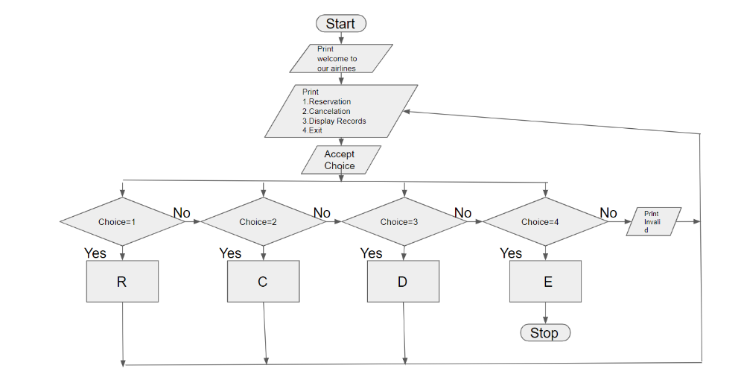
Reservation
Cancel
Display
Exit

Slide 13
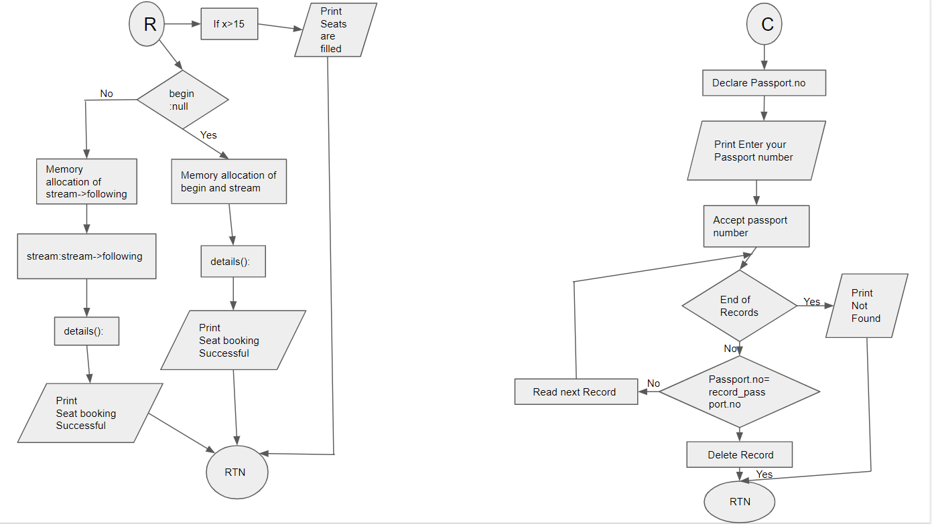
Reservation :
Cancel:

Slide 14
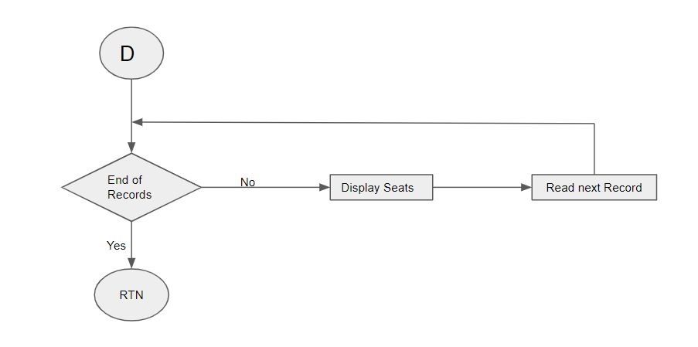
Display:

Slide 15
#include<stdio.h>
#include<stdlib.h>
#include<conio.h>
#include<string.h>
struct vicar_airline
{
int passport[6];
char name[15];
int seat_num;
char email[15];
struct vicar_airline *following;
}
*begin, *stream;
struct vicar_airline *dummy;
void main()
{
void reserve(int x), cancel(), display(), savefile();

Slide 16
int choice;
begin = stream = NULL;
int num = 1;
do
{
printf("Welcome To Vicar Airlines Online Booking Hub\n");
printf("1. Reservation\n");
printf("2. Cancel\n");
printf("3. Display Records\n");
printf("4. Exit\n");
printf("Enter Your Choice\n");
scanf("%d", &choice);
switch (choice)
{
case 1:
reserve(num);
num++;
break;

Slide 17
case 2:
cancel();
break;
case 3:
display();
break;
case 4:
{
savefile();
break;
}
default:
printf("ENTER VALID CHOICE(1-4)");
printf("Press Any Key To Go Back To Main Menu");
}
getch();
} while (choice != 4);
}

Slide 18
void details()
{
printf("Enter Your Passport Number: ");
scanf("%s", stream->passport);
printf("Enter your name: ");
scanf("%s", stream->name);
printf("Enter your email address: ");
scanf("%s", stream->email);
}
void details();
void reserve(int x)
{
stream = begin;
if (begin == NULL)
{
// first user
begin = stream = (struct vicar_airline*)malloc(sizeof(struct vicar_airline));
details();

Slide 19
stream->following = NULL;
printf("Seat Booking Successful!\n");
printf("Your Seat Number Is: Seat A-%d", x);
stream->seat_num = x;
return;
}
else if (x > 15)
{
printf("\nSeats Full");
return;
}
else
{
// next user
while (stream->following)
stream = stream->following;
stream->following = (struct vicar_airline *)malloc(sizeof(struct vicar_airline));
stream = stream->following;

Slide 20
details();
stream->following = NULL;
printf("\nSeat Booking Succesful!");
printf("\nYour Seat Number Is: Seat A-%d", x);
stream->seat_num = x;
return;
}
}
void savefile()
{
FILE *fpointer = fopen("Vicar Records", "w");
if (!fpointer)
{
printf("\n Error In Opening File!");
return;
}
stream = begin;

Slide 21
//fprintf(fpointer, "Passport No.\t\t\tName\t\t\tEmail\n");
while (stream)
{
fprintf(fpointer, "%-6s", stream->passport);
fprintf(fpointer, "%-15s", stream->name);
fprintf(fpointer, "%-15s", stream->email);
fprintf(fpointer, "\n");
stream = stream->following;
}
printf("Details Have Been Saved To A File (Vicar Records)");
fclose(fpointer);
}
void display()
{
stream = begin;
while (stream)
{

Slide 22
printf("\nPassport Number : %-6s", stream->passport);
printf("\nName : %-15s", stream->name);
printf("\nEmail addressddress: %-15s", stream->email);
printf("\nSeat number: A-%d", stream->seat_num);
stream = stream->following;
}
}
void cancel()
{
stream = begin;
char passport[6];
printf("\nEnter Passort Nmber to Delete Record?:");
scanf("%s", passport);
if (strcmp(begin->passport, passport) == 0)
{
dummy = begin;
begin = begin->following;

Slide 23
free(dummy);
printf("Booking Has Been Deleted\n");
return;
}
while (stream->following)
{
if (strcmp(stream->following->passport, passport) == 0)
{
dummy = stream->following;
stream->following = stream->following->following;
free(dummy);
printf("Has Been Deleted\n");
getch();
return;
}
stream = stream->following;
}
printf("Passport Number Is Wrong Please Check Your Passport\n");
}

Slide 24
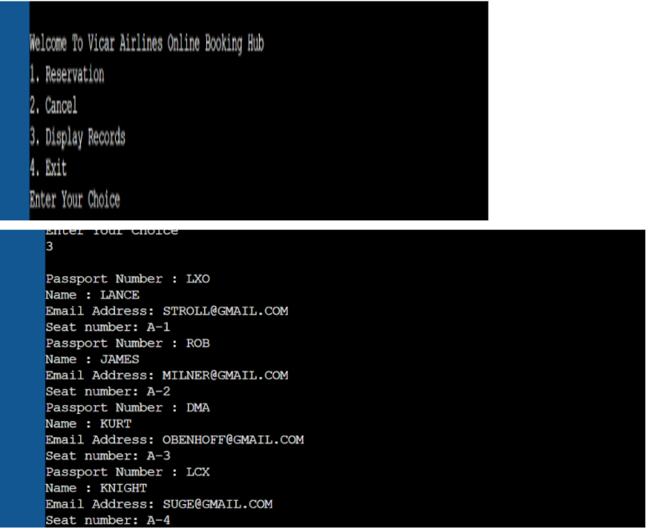
Snapshots of the result and discussion

Slide 25
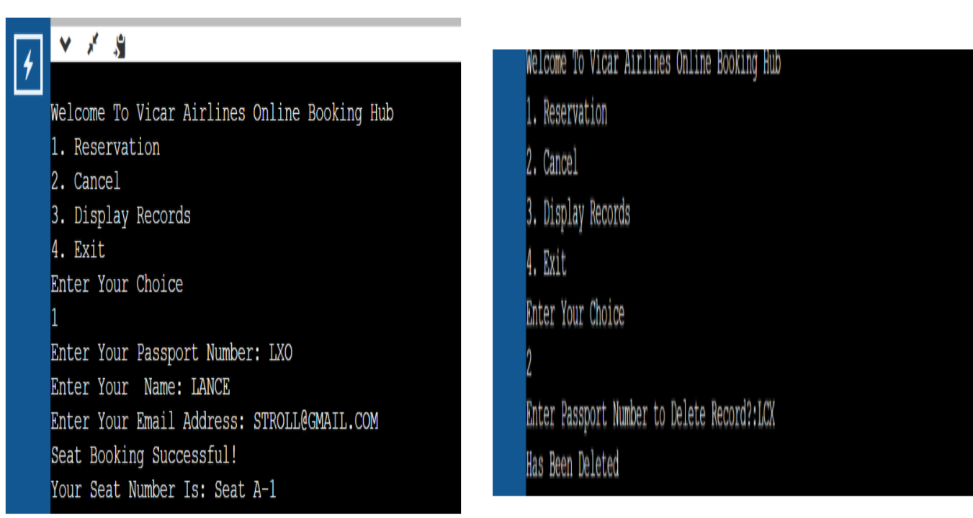

Slide 26
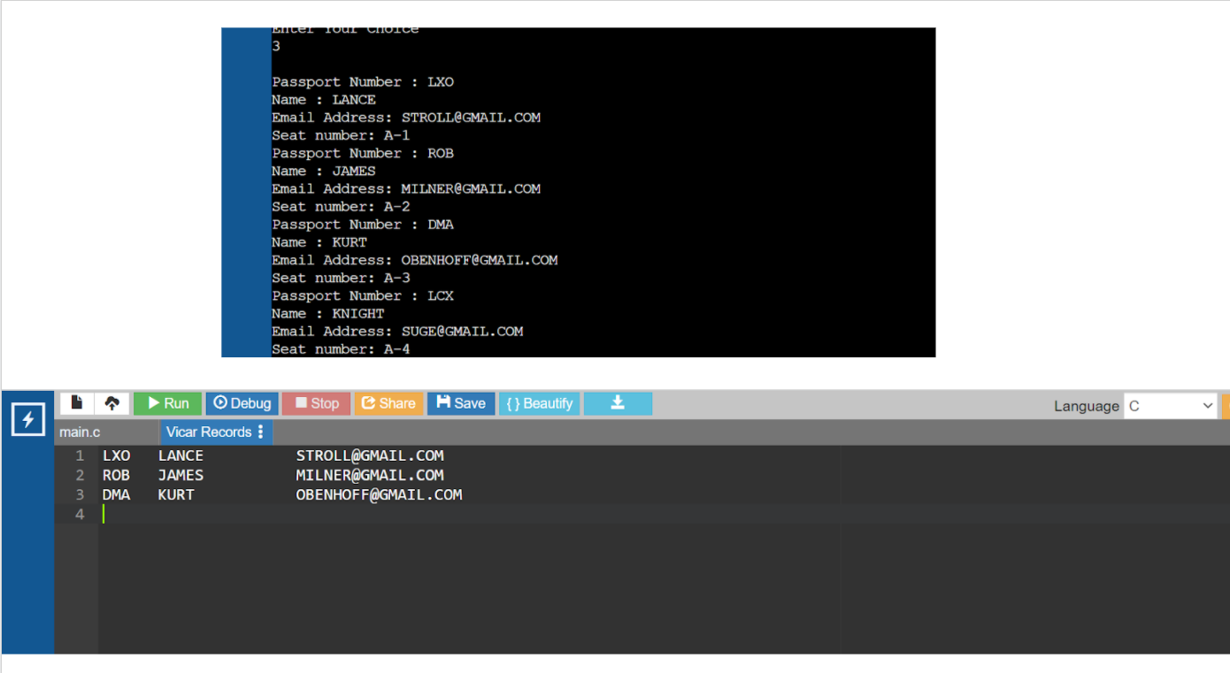

Slide 27
CONCLUSION
The Airline reservation system is designed for users to reserve a seat, cancel,
display seat and exit the system. A formula is included in the function to calculate the seats are reserved. Pseudocode is written for some important codes. A few flow charts are also created for explaining the process of the Airline reservation system.From this assignment, We have learnt to implement a few C concepts in the future projects such as functions, switch statement and do…while statement, arrays, pointers and structures in the program. We have also learnt to create flow charts for explaining the program using https://app.diagrams.net/

Slide 28
Thank You

